Slide 1

  Chapter One
  Introduction to Data Communications
  and
  computer networks

Slide 2

Chapter Outline
  Basics of data communications
  Basic components of communication network
  Current and future networks
  Fundamentals of Information Transmission Media and Coding
  Types of networks [PP &CS]
  Basic Data Communication Hardware [NIC, cables, Switch, Router, Hub, Bridge…]
  Basic types of network Topologies: ring, bus, star, and mesh

Slide 3
Introduction
Information: defined as a collection of facts from which conclusions may be drawn is an important resource
The need of information has increased from time to time
  leads to the need of sharing of information among different agents
Data communication is the exchange of information between two agents
Old paradigm:
  A single powerful computer serving all the needs of an organization
  Sneaker-net is Method of sharing data by copying it to a disk and carrying it from computer to computer

Slide 4
Cntd…
New paradigm
  Computer networks: a large number of separate (autonomous) but internetworked (being able to exchange information) computers doing the job
    Merging of computer and communications technologies – no geographical barrier
    Connection(transmission media): copper wire, fiber optics, microwaves, infrared, communication satellites, …
Definition:
  A computer network is an interconnected collection of autonomous computers.

Slide 5
Cntd…
Interconnected meaning two computers have the ability to exchange information using some transmission media.
Autonomous meaning where no one computer controls any other computer (i.e. no computer can forcibly start or stop another computer)
Computers can be PC’s, workstations and other “specialized” computers such as hubs, switches and routers
The computers can be geographically located anywhere

Slide 6
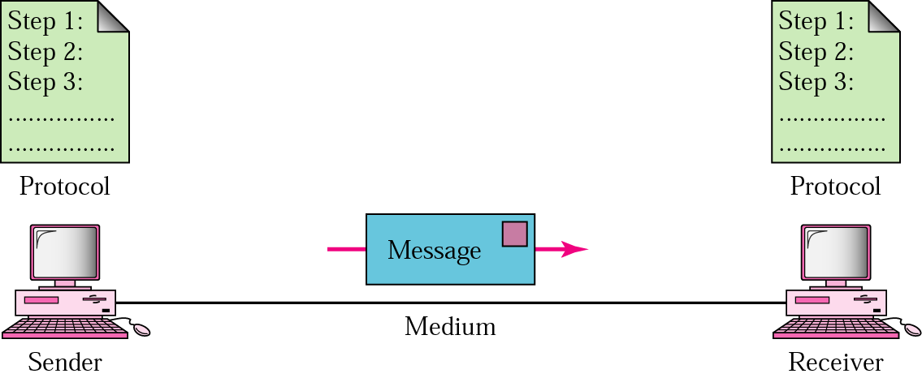
Overview of Data Communications
  A data communication system has 5 components
  Message: the information to be communicated (text, numbers, pictures, sound, video - or combinations)
  Sender: the device source of information- computer, video camera, …
  Receiver: the device destination of the inforamation
  Medium: the physical path by which a message travels from sender to receiver
  Protocol: the set of rules that govern data communications; an agreement between the communicating devices.

Slide 7
Communication Model
The key elements of the model are:
  Source: This device generates the data to be transmitted; examples are telephones and personal computers.
  Transmitter: transforms and encodes the information in such a way as to produce electromagnetic signals.
  Transmission System: This can be a single transmission line or a complex network connecting source and destination.
  Receiver: The receiver accepts the signal from the transmission system and converts it into a form that can be handled by the destination device.
  Destination: Takes the incoming data from the receiver

Slide 8
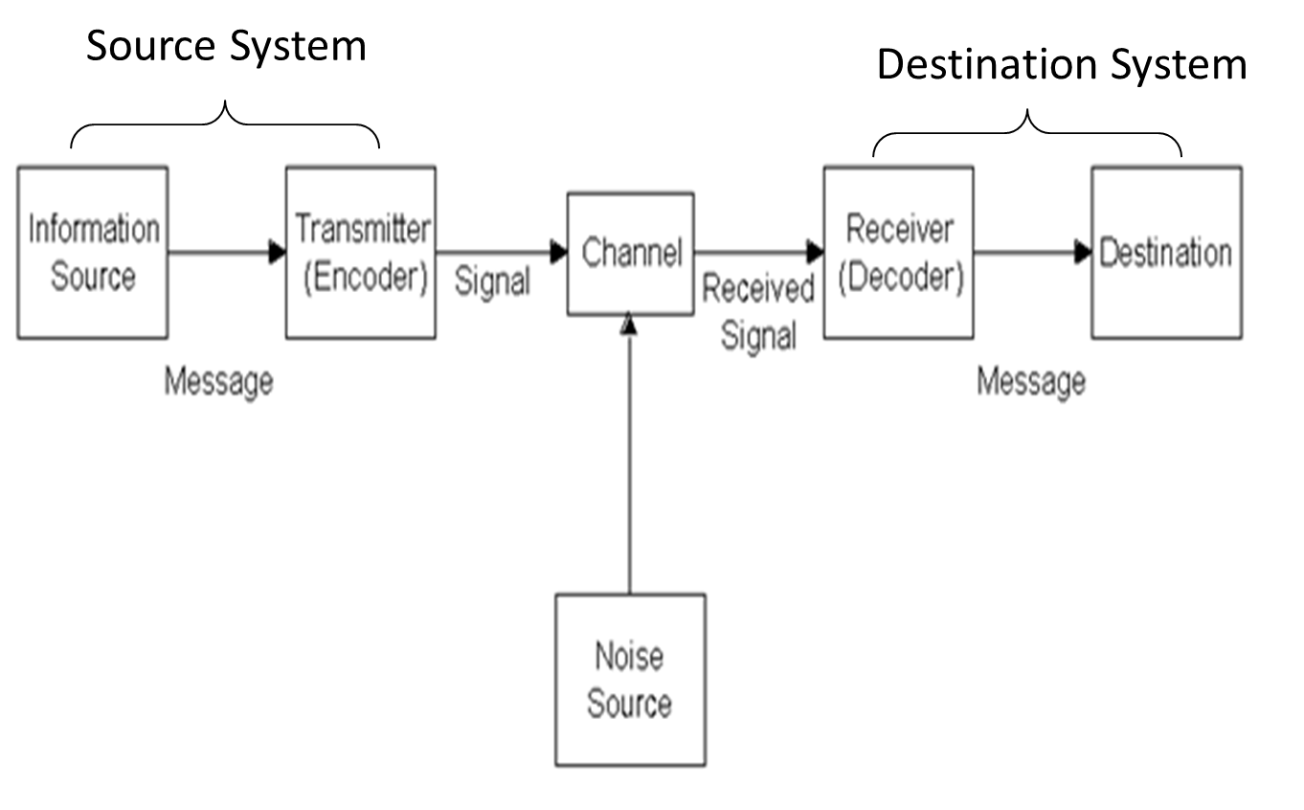
Cntd…
Communication Model

Slide 9
Some Key Of Communications Tasks
Transmission System Utilization: the need to make efficient use of transmission facilities that are typically shared among a number of communicating devices
    Multiplexing
    Congestion control techniques
Signal Generation: The properties of the signal
    capable of being propagated through the transmission system
    Interpretable as data at the receiver
Error detection and correction: In all communications systems, there is a potential for error that should be detected and corrected.

Slide 10
Cntd…
Addressing and routing: a source system must somehow indicate the identity of the intended destination
  A specific route must be chosen from many alternative routes
Flow control: required to assure that the source does not overwhelm the destination by sending data faster than they can be processed and absorbed
Protocols: Rules that govern data communication, including error detection, message length, and transmission speed
Attenuation: Loss of power in a signal as it travels from the sending device to the receiving device

Slide 11
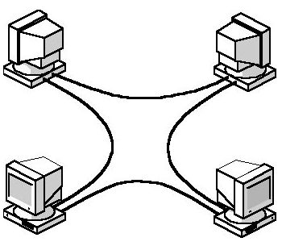
Network Categories
Based on size, ownership, the distance it covers
Local Area Network (LAN): usually privately owned and links devices in a single office, building or campus.
Wide Area Network (WAN): covering large geographic area; may utilize public, leased, or private communications equipment

Slide 12
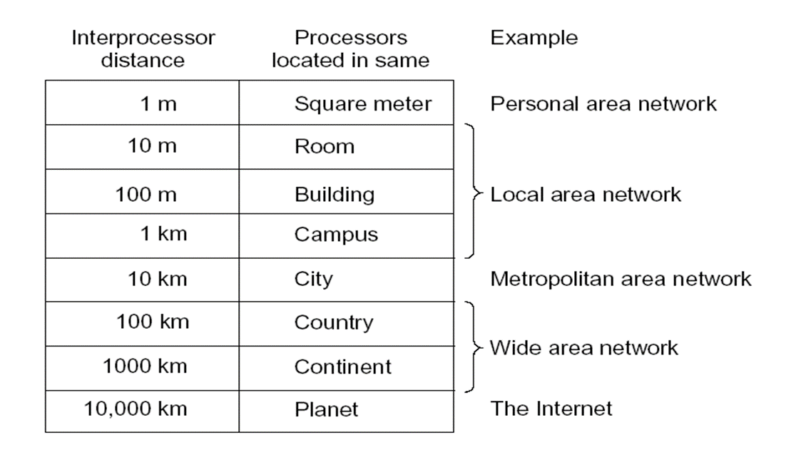
Cntd…
Metropolitan Area Network (MAN): designed to extend over an entire city; it may be a single network or interconnected LANs
Personal Area Network (PAN): meant for one person. e.g. a wireless network connecting a computer with its mouse, keyboard and printer.

Slide 13
Cntd …
Network Architecture: includes the type of computers on the network and determines how network resources are handled.
Two common types (Peer to Peer and Client to Server)
Peer-to-peer: Each node considered as equal in terms of resource sharing and responsibilities
pros
    Easy to set up
    Less expensive
    Demands moderate level of skill to administer
    User is able to control their own resources
  Cons
    Only < 10 nodes
    Very low level of security
    Performance suffers when a computer is accessed

Slide 14
Cntd…
Peer-to-peer networks are good choices for environments where:
    There are 10 users or fewer
    Users share resources, such as printers, but no specialized servers exist
    Security is not an issue
    The organization and the network will experience only limited growth within the foreseeable future

Slide 15

Cntd…
  B. Client to Server Model: the client request for a service and the server deliver the resource(resourceful).
    Consists of a group clients connected to a server
    Server – with more RAM, larger hard disk, more processing power…

Slide 16
Cntd…
Servers in networking
File and Print Servers: File and print servers manage user access and use of file and printer resources.
Application Servers: Application servers make the server side of client/server applications, as well as the data, available to clients.
an application server differs from a file and print server. With a file and print server, the data or file is downloaded to the computer making the request. With an application server, the database stays on the server and only the results of a request are downloaded to the computer making the request.

Slide 17
Cntd…
3. Mail Servers: Mail servers operate like application servers in that there are separate server and client applications, with data selectively downloaded from the server to the client.
4. Fax Servers: Fax servers manage fax traffic into and out of the network by sharing one or more fax modem boards.
5. Directory Services Servers: Directory services servers enable users to locate, store, and secure information on the network.

Slide 18
Network Topology
  Topology refers to the way in which multiple devices are interconnected via communication links.
  There are two types of topology: physical and logical.
  Physical Topology
    Refers to the way in which a network is laid out physically
    Refers to the arrangement or physical layout of computers, cables, and other components on the network
    Can be referred as Physical layout, Design, Diagram, Map
    Two or more devices connect to a link; two or more links form a topology
  Logical topology: is bound to network protocols and describe how data is moved across the network

Slide 19
Cntd…
  A network's topology affects its capabilities
  The choice of one topology over another will have an impact on:
    The types of equipment that the network needs
    The growth of the network – scalability
    The way the network managed
  Four basic topologies are possible: bus, star, ring, mesh, and hybrid

Slide 20
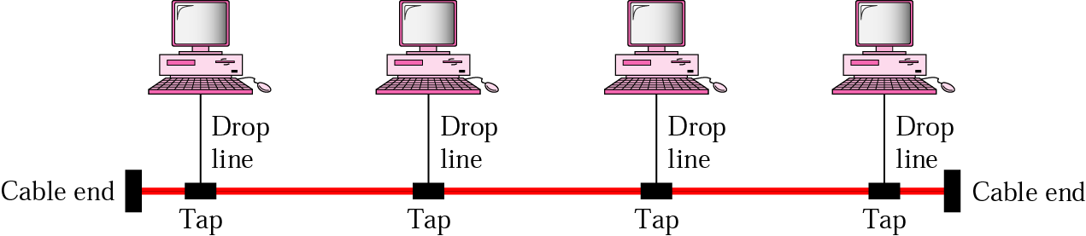
Cntd…
1. Bus: multipoint (one long cable acts as a backbone to link all the devices in the network)
Advantages
  Easy to connect a computer or peripheral to a bus.
  Requires less cable length than a star topology.
Disadvantages
  Entire network shuts down if there is a break in the main cable.
  Terminators are required at both ends of the backbone cable.
  Difficult to identify the problem if the entire network shuts down.
  Not meant to be used as a stand-alone solution in a large building.

Slide 21
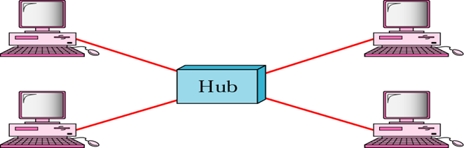
Cntd…
2. Star: each device has a dedicated point-to-point link only to a central controller, usually called a Concentrator
Advantages
  robust; a failure of a link has no effect on others
  fault identification and isolation are easy
  less expensive than mesh (but more expensive than others)
Disadvantage
  Single point of failure
  Requires more cable length than a linear topology
  More expensive than linear bus topologies because of the cost of the concentrators.

Slide 22
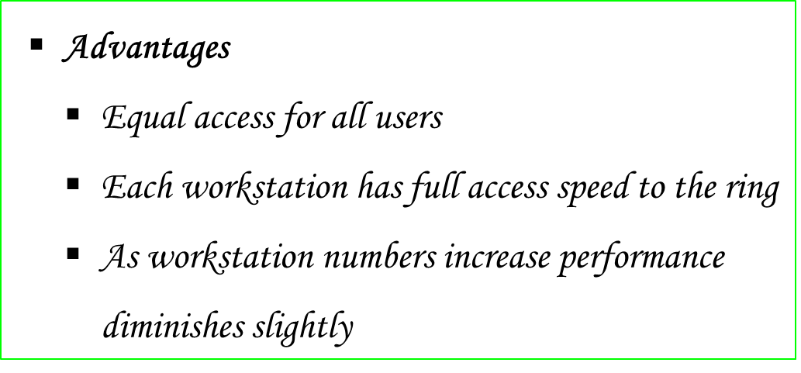
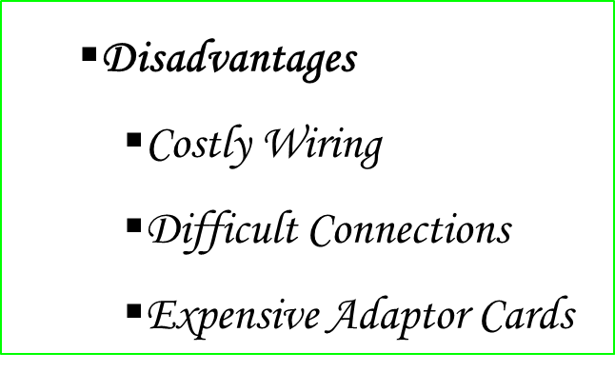
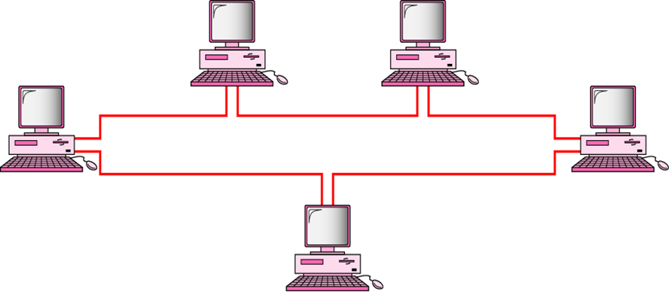
Cntd…
3. Ring: each device has a dedicated point-to-point connection only with the two devices on either side of it.
  a signal is passed along the ring in one direction, from device to device, until it reaches its destination
  each device incorporates a repeater

Slide 23
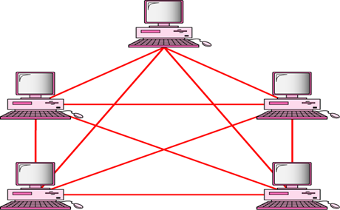
Cntd…
4. Mesh: every device has a dedicated point-to-point link to every other device
  every device must have n-1 I/O ports
Advantages
  no traffic problem
  robust; a failure of a link has no effect on others
  privacy or security
  fault identification and isolation are easy
Disadvantages: amount of cabling and I/O ports needed (expensive)
5. Hybrid topology: A combination of two network topologies.
    E.g. star and bus

Slide 24
Internetworking
Interconnection among or between public, private, commercial, industrial, or governmental networks Called also internet
Three variants
    Intranet
    Extranet
    Internet
    internet
Intranet: a set of networks that is under the control of a single administrative entity
Internet: Global network of networks
    worldwide interconnection of networks
internet –refers to bridged network in general
Extranet: is a private network similar to an intranet, but typically open to external parties, such as business partners, suppliers, key customers, etc

Slide 25
Mode of transmission
refers to the direction of signal flow between two linked devices
It can be
  Simplex: unidirectional, only one of the devices can transmit
  E.g. TV transmission, radio
  Half-duplex: both can transmit and receive, but not at the same time
    E.g. wireless handset (walkie -Talkie)
  Full-duplex: both can transmit and receive at the same time
    E.g. Telephone transmission

Slide 26
Transmission media
    Is a physical media that carries a signal from the transmitter to the receiver
    The information or signal transmitted from one device to another is through electromagnetic signals.
    Electromagnetic signals include power, voice, radio, waves, infrared light, visible light, ultraviolet light, X-rays, and gamma rays.
    These signals can travel through vacuum, air or any other transmission medium
    The measurement of the quantity of data that can be passed down(transmitted) a communication link in a given time is done in terms of bandwidth (bits per second).

Slide 27
Cntd…
Two basic categories
    Guided
    Unguided
Guided: uses a cabling system that guides the signals along a specific path.
E.g. Fiber Optics, Twisted Pair, Coaxial Cable etc.…
Unguided: consists of a means for the data signals to travel but nothing to guide them along a specific path - wireless .
E,g., Radio wave, Satellite, etc.

Slide 28
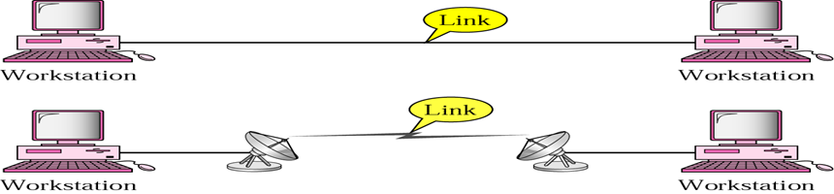
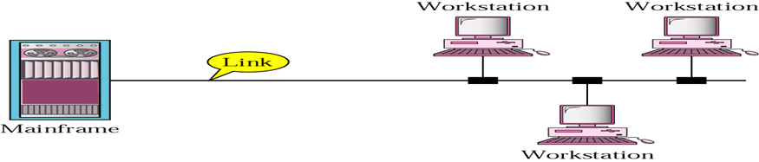
Types of connection
Point-to-point: provides a dedicated link between two devices
Multipoint: more than two devices share (spatially -simultaneously -or temporally by taking turns) a single link
Direct link: signals propagate directly from transmitter to receiver
  No intermediate devices other than amplifiers or repeaters
  This can apply to both guided and unguided medium
Indirect link: Systems connected through a switched communication network

Slide 29
Uses of Computer Networks
Business applications
for resource sharing including programs, equipment, data (mostly databases on central servers), …
a communication medium – e-mail, writing a report together by making changes on an online document
videoconferencing – to hold meetings by hearing and seeing each other
electronic business
  business to business - placing orders, …
  business with consumers, usually called e-commerce – home shopping
Everything: government, commercial companies, …

Slide 30
Fundamental of information transmission media $ Encoding
Data transmission occurs between transmitter and receiver over some transmission medium
Transmission media may be classified as guided or unguided
In both cases communication is in the form of electromagnetic waves
The successful transmission of data depends on
  the quality of the signal being transmitted
  the characteristics of the transmission medium

Slide 31
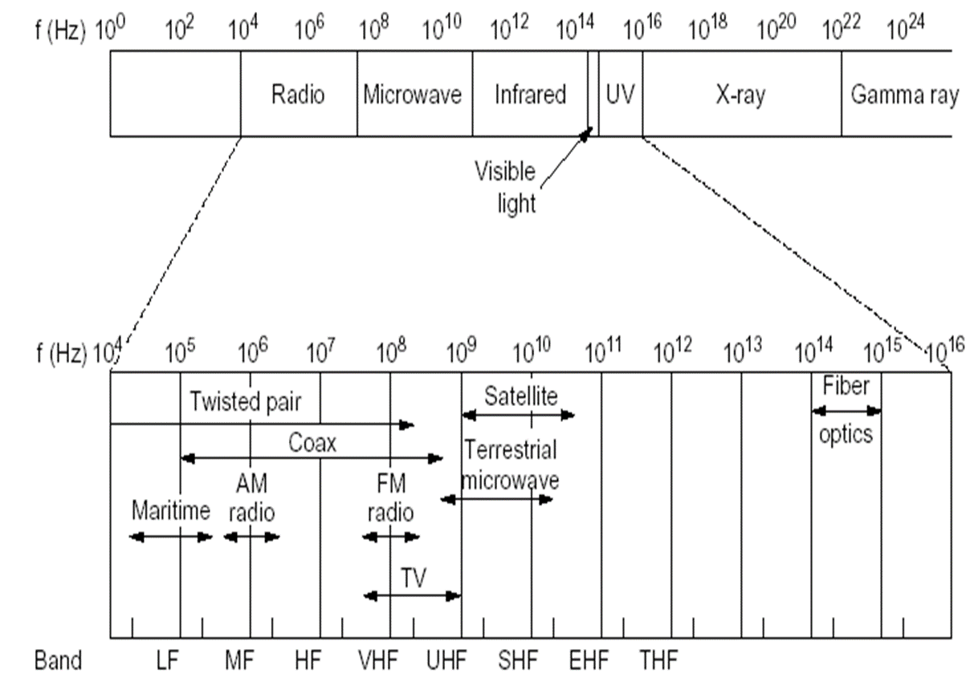
Cntd…

Slide 32
Analog and digital data representation
In transmitting data from a source to a destination:
  the nature of the data
  the transmission media used to propagate the data
  what processing or adjustments may be required along the way to assure that the received data are understandable
Generally whether we are dealing with analog or digital entities
The term analog and digital correspond, roughly to continuous and discrete respectively
Data: Entities that convey meaning can be
  i. analog: data take on continuous values on some interval, i.e. continuously varying patterns of intensity.
        E.g. Audio, video, temperature, etc
  ii. Digital: data take on discrete values. E.g. text or character strings

Slide 33
Cntd…
Signals: Electric or electromagnetic representations of data
Can be also digital or analog
analog signal is a continuously varying electromagnetic wave that may be propagated over a variety of media .
Three important characteristics: Amplitude, Frequency, Phase
  Frequency Spectrum of a signal is the collection of all component frequency
  Bandwidth of a signal is the range of component frequencies or the width of the frequency spectrum
  Amplitude: The value of the signal at any point. measured in volts, amperes, or watts

Slide 34
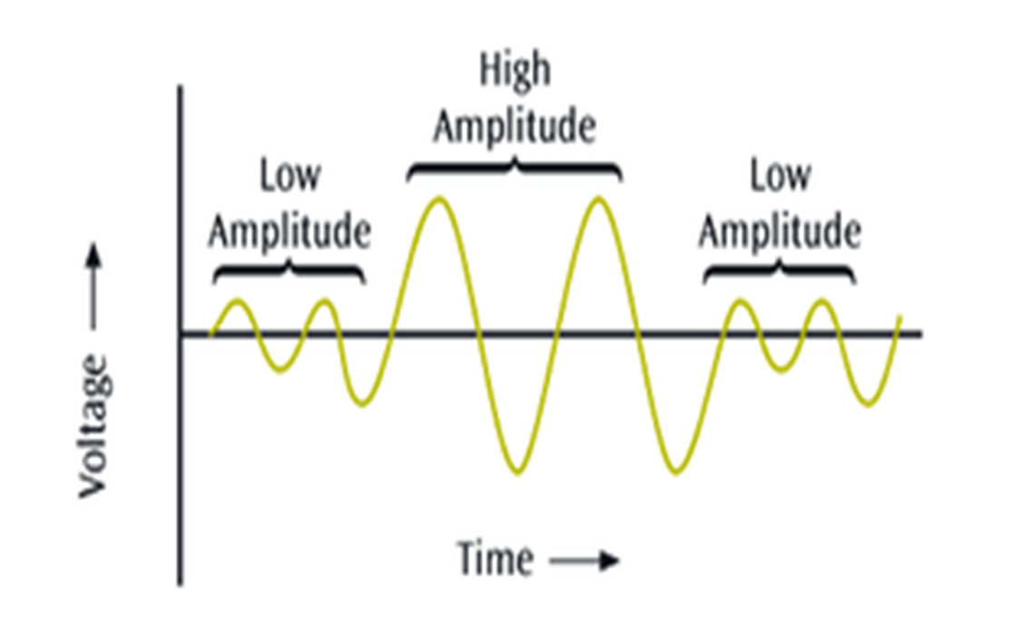
Cntd…

Slide 35
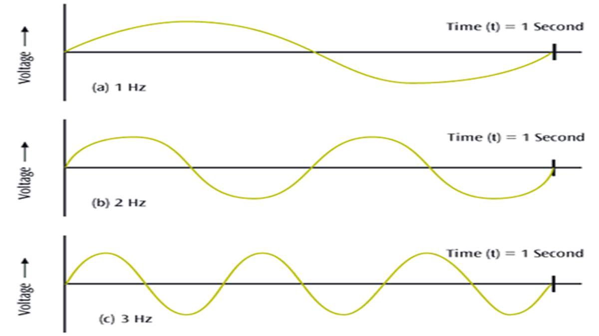
Cntd…
Frequency : The number of periods in one second
Period : the amount of time, in seconds, a signal needs to complete one cycle.
Period and frequency have inverse relationship.

Slide 36
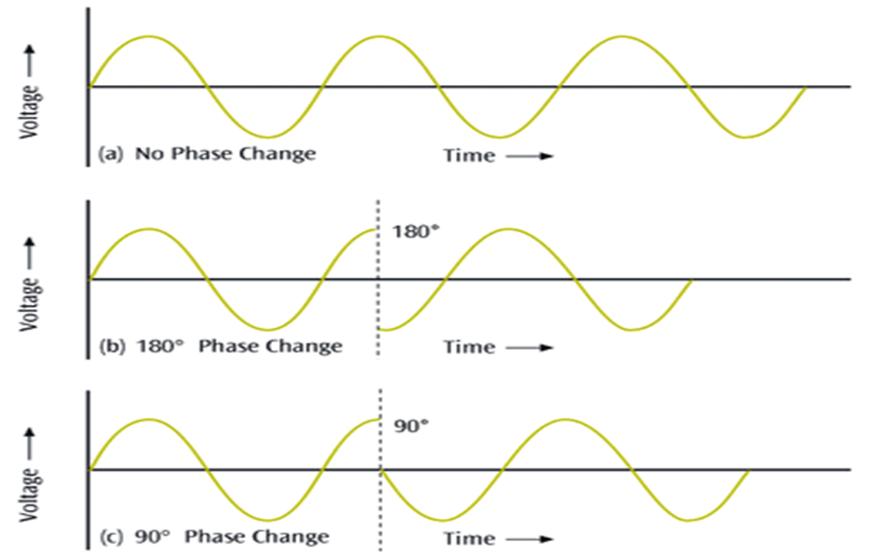
Cntd…
Phase: The position of the waveform relative to time zero

Slide 37
Cntd…
A digital signal is a sequence of voltage pulses that may be transmitted over a wire medium
Bit Interval: the time required to send a single bit
Bit rate: the number of bit intervals per second usually expressed in bits per second (bps)
Signaling is the physical propagation of the signal along a suitable medium
Transmission
Communication of data by propagation and processing of signals
The way signals are treated is a function of the transmission system
Analog transmission is a means of transmitting analog signals without regard to their content the signals may represent analog data (e.g., voice) )
Digital transmission, in contrast, is concerned with the content of the signal.

Slide 38
Cntd…
Which is the preferred method of transmission?
  Digital transmission is preferable
The reasons are
  Digital technology are:
    Continuing to drop in cost and size
    Analog equipment has not shown a similar drop
  Data integrity
    With the use of repeaters the effect of noise and other signal impairments are not cumulative (increasing)
  Capacity utilization
    High degree of multiplexing
  Security and privacy
    Encryption techniques can be readily applied to digital data and to analog data that have been digitized

Slide 39
Transmission Impairments
Signal received may differ from signal transmitted
Analog - degradation of signal quality
Digital - bit errors
  A binary 1 is transformed into a binary 0 and vice versa
Caused by
  Attenuation and attenuation distortion
  Delay distortion
  Noise
Solution
  Amplifiers – analog signal
  Repeaters – digital signal
Notes:
Attenuation= thinning or decreasing

Slide 40
Cntd…
Attenuation: it is a phenomenon which occurs when signal strength falls off with distance
It depends on medium, such as Fiber optic cables carries signal without attenuation up to 2Km.
In communicating entities, received signal strength:
  must be enough to be detected
  must be sufficiently higher than noise to be received without error
Delay Distortion: this distortion can only occur in guided media
  Propagation velocity varies with frequency
  various frequency components of a signal will arrive at the receiver at different times

Slide 41
Cntd…
Noise: additional signals inserted between transmitter and receiver is known as noise
Noises can be caused by
  Thermal: Due to thermal worry of electrons in a conductor
  Crosstalk: A signal from one line is picked up by another
  Impulse Noise : is sharp quick spikes on the signal caused from electromagnetic interference, lightning, sudden power switching, electromechanical switching, etc
  inter-modulation noise means a noise may occurred during changing from digital to analog or from analog to digital.

Slide 42
Signal vs data
Analog signals can represent analog and digital data and digital signals can represent digital as well as analog data
Analog data are a function of time and occupy a limited frequency spectrum.
Such data can be represented by an electromagnetic signal occupying the same spectrum
Digital data can be represented by digital signals
  Different voltage level for each of the two binary digits is used
Digital data can also be represented by analog signals
  Using modem
Analog data can be represented by digital signals
  Using codec

Slide 43
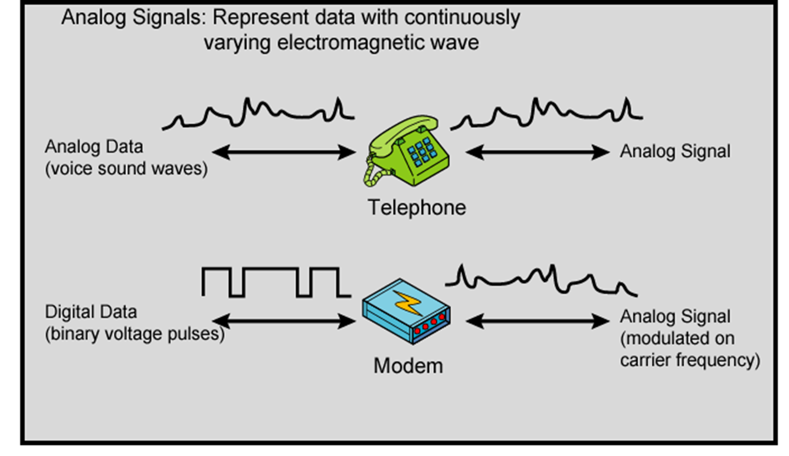
Analog Signals Carrying Analog and Digital Data

Slide 44
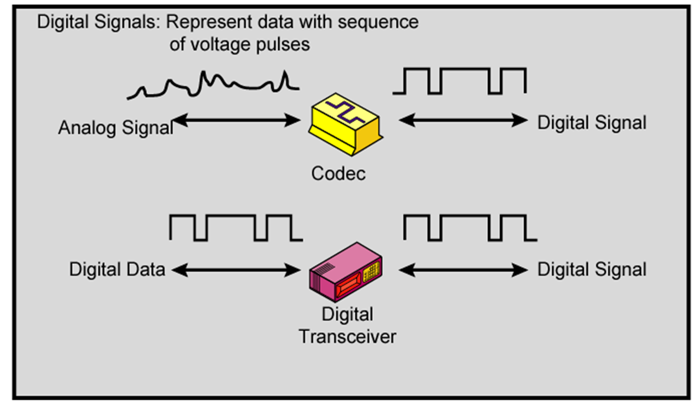
Digital Signals Carrying Analog and Digital Data

Slide 45
Encoding and Modulation Techniques
Encoding: the process of preparing data for efficient and accurate transmission
Modulation: the process of encoding a baseband source signal Sm (t) onto a carrier signal
Four combinations
    Digital data, digital signal
    Analog data, digital signal
    Digital data, analog signal
    Analog data, analog signal

Slide 46
Digital Data, Digital Signal:
A digital signal is a sequence of discrete, discontinuous voltage pulses
Each pulse is a signal element.
Binary data are transmitted by encoding each data bit into signal elements
  E.g. binary 0 is represented by -5V and binary 1 by +5V
At the receiving end the receiver:
  must know the timing of each bit. That is, the receiver must know with some accuracy when a bit begins and ends
  must determine whether the signal level for each bit position is high (1) or low (0)

Slide 47
Cntd…
Success factors of a system: refer to the performance metrics that determine the effectiveness of the system in transmitting information
  the signal-to-noise ratio
  the data rate
  the bandwidth
The encoding scheme that can be used can also improve performance
Encoding schemes
  1) Non-return to Zero /NRZ
    NRZ-L
    NRZ-I
  2) Bi-phase
    Manchester
    Differential Manchester
  3) Return to Zero (RZ) (reading Assignment)

Slide 48
Cntd….
NRZ: Uses two different voltage levels (one positive and one negative) as the signal elements for the two binary digits
E.g. Absence of voltage for zero, constant positive voltage for one
More often, negative voltage for one value and positive for the other
Two Variants
  NRZ-L
  NRZ-I
NRZ-L: Digital 1s are represented as one voltage (amplitude), while digital 0s are represented as another:
  Cheap to implement
  Check for voltage of each bit
  A long series of 1s or 0s produces a flat, unchanging voltage level (produces synchronization problems)

Slide 49
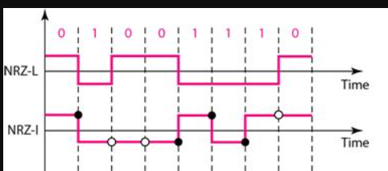
Cntd….
NRZ-I: Digital 1s are represented by a voltage change (high-to-low, or low-to-high),
while 0s are represented as a continuation of the same voltage level:
  1 ⬄ existence of a signal transition at the beginning of the bit time (either a low-to-high or a high-to-low transition)
  0 ⬄ no signal transition at the beginning of the bit time
  Even cheaper to implement (only check for changes)
A long series of 0s produces a flat, unchanging voltage level

Slide 50
Cntd….
NRZ Pros and Cons
Pros
  Easy to engineer which a simple and straightforward method of encoding digital data, which is easy to implement in hardware or software.
  Makes good use of bandwidth: uses the entire bandwidth of the communication channel
Cons
  dc component (average voltage level of the signal may be non-zero, cause problems with signal transmission over certain types of communication channels
  Lack of synchronization capability
  Used for magnetic recording
  Not often used for signal transmission( not use for long distance )

Slide 51
Biphase
Manchester
  Transition in middle of each bit period
  transition in middle of each bit time serves as clocking signal
  Low to high transition represents a one
  high to low transition represents a zero
  Used by IEEE 802.3
    Used in 802.3 baseband coaxial cable and carrier sense multiple access / collision detection (CSMA/CD) twisted pair.
Differential Manchester
  the mid-bit transition is used for clocking purposes
  transition at the start of a bit period represents a one,
  no transition at the start of a bit period represents a zero.
  used by IEEE 802.5, standard for Token Ring networking
  used in the 802.5 Token Ring LAN with twisted pair cable.

Slide 52
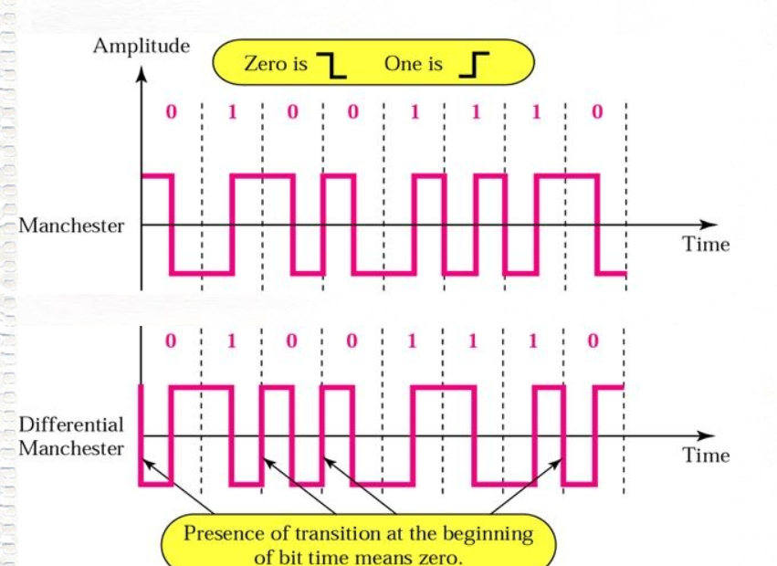
Biphase

Slide 53
Digital Data, Analog Signals
The most familiar use of this transformation is for transmitting digital data through the public telephone network using modem
Basis for analog signaling is a continuous, constant-frequency signal known as the carrier frequency.
Digital data is encoded by modulating one of the three characteristics of the carrier: amplitude, frequency, or phase or some combination of these.
there are three basic encoding or modulation techniques
  Amplitude-shift keying (ASK)
  Frequency-shift keying (FSK)
  Phase-shift keying (PSK)

Slide 54
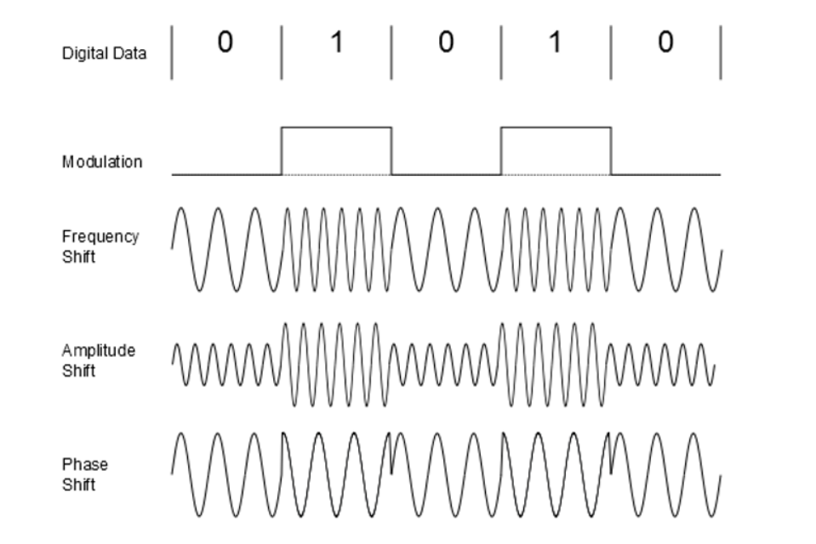
Cntd…
Amplitude-shift keying (ASK): the two binary values are represented by two different amplitudes of the carrier frequency
  one of the amplitudes is zero the other with value one
Frequency-shift keying (FSK): the two binary values are represented by two different frequencies near the carrier frequency
Phase-shift keying (PSK):the carrier signal is modulated that it transitions between different phase angles to represent different symbols or bits.

Slide 55
Analog Data, Digital Signals
To send continuous data such as voice information over a digital transmission medium
Example: To transfer analog voice signals off a local loop to digital end office within the phone system, one uses a codec
The most common technique for using digital signals to encode analog data is Pulse Code Modulation(PCM)
Pulse Code Modulation(PCM)
Steps
  sample the continuous data - to measure the value of the continuous data at equal interval
    Each sample is called Pulse
  the resulting pulse is quantized - assigned a value
  each value is transformed to assign-and-magnitude binary number

Slide 56
Analog Data, Analog Signal
There are two principal reasons
  A higher frequency may be needed for effective transmission
  Modulation permits frequency-division multiplexing
The principal techniques for modulation using analog data are:
amplitude modulation (AM): is simple to implement and used in commercial radio broadcasting, but susceptible to noise and interference.
frequency modulation (FM) : is less susceptible to noise and interference than AM and used in FM radio broadcasting and mobile communications, but requires more bandwidth
phase modulation (PM) :is used in applications such as phase-shift keying and is more robust to noise than AM, but more complex to implement than AM and FM

Slide 57
Multiplexing
term used to refer to a process where multiple analog message signals or digital data streams are combined into one signal over a shared medium
to share an expensive resource
multiplexing divides the capacity of the low-level communication channel into several higher-level logical channels, one for each message signal or data stream to be transferred
A reverse process, known as demultiplexing, can extract the original channels on the receiver side
The two most basic forms of multiplexing are :
  Time-division multiplexing (TDM) –for digital signal
  Frequency-division multiplexing (FDM) –for analog signal

Slide 58
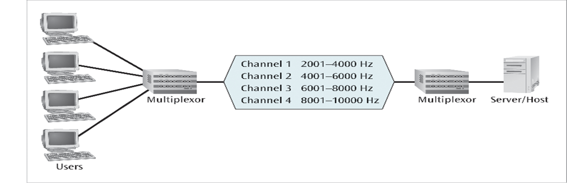
Cntd…
FDM
  The frequency spectrum is divided into frequency bands, with each user having exclusive possession of some band
  possible when the useful bandwidth of the transmission medium exceeds the required bandwidth of signals to be transmitted
  the frequency-division multiplexing (FDM) used for analog signals.
  A number of signals can be carried simultaneously if each signal is modulated onto a different carrier frequency
  carrier frequencies are sufficiently separated that the bandwidths of the signals do not overlap

Slide 59
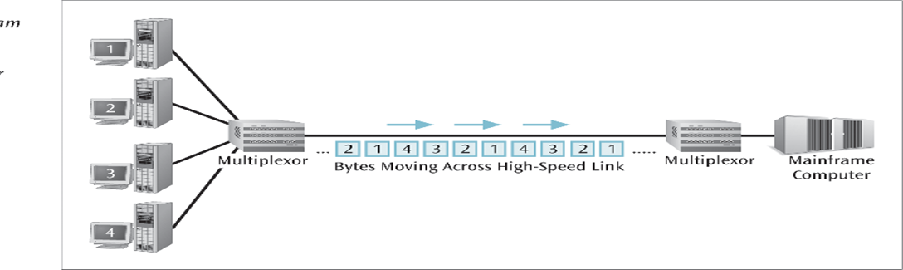
Cntd…
TDM
  The users take turns, each one periodically getting the entire bandwidth for a little burst of time.
  time-division multiplexing (TDM) is used for digital signals
  With TDM, there is no inter-modulation noise, whereas we have seen that this is a concern for FDM.
  possible when the achievable data rate (sometimes, called bandwidth) of the medium exceeds the data rate of digital signals to be transmitted
  Multiple digital signals (or analog signals carrying digital data) can be carried on a single transmission path by interleaving portions of each signal in time.

Slide 60
Data communication hardware
Networking hardware
are physical devices that allow hardware on a computer network to communicate and interact with one another
Hub - connecting multiple devices from different stations
  cannot filter data (sent to all connected devices)
  they do not have intelligence to find out the best path for data packets which leads to inefficiencies and wastage.
Switch -A switch operates in the layer 2, i.e. data link layer of the OSI model.
It is an intelligent network device
It uses MAC addresses to send data packets to selected destination ports.
It uses packet switching technique to receive and forward data packets from the source to the destination device

Slide 61
Data communication hardware …
Router - a device used to connect two or more different networks ( two LANs or two WANs) .
  The routers evaluate the best route from a sender to a receiver.
  By perform in a routing protocol to create the network topology
  It is layer 3 device of the OSI model
Bridge - It combines two LANs to form an extended LAN.
  are intelligent devices that allow the passing of only selective packets from them.
  only passes those packets addressed from a node in one network to another node in the other network.

Slide 62
Data communication hardware …
Repeater - a devices operating at physical layer of the OSI model
  It amplify or regenerate an incoming signal before retransmitting it.
  It also known as signal boosters.
NIC - allows communications between computers connected via local area network (LAN) as well as Internet Protocol (IP).
  NIC allows both wired and wireless communications.
  NIC is both a physical layer and a data link layer device
Cables - the physical medium used to transfer data from one device to another
twister pair cable ( Unshielded and shielded twisted pair cable )
coaxial cable ( thin net and think net )
fibler optica cable (Single mode and multimode)

Slide 63
Current and future networks
Current and future networks refer to the various types of computer networks that are currently in use or being developed for use in the future.
Current networks include a variety of wired and wireless networks, such as Ethernet, Wi-Fi, cellular networks, satellite networks, and more
Future networks are being developed to address the ever-increasing need for faster, more reliable, and more secure communication.
Some of the future network technologies being explored include 5G networks, Wi-Fi 6, mesh networks, software-defined networks (SDN), internet of things (IoT) networks, quantum networks, and 6G networks.
These networks are expected to enable new applications and services, improve productivity, and enhance the overall user experience.

Slide 64
End of chapter one
Any question???

